Slide 1
Effective Use Cases for Real-Time Design
Bruce Powel Douglass, Ph.D.
Chief Evangelist
I-Logix, Inc.
www.ilogix.com
bpd@ilogix.com

Slide 2
Agenda
What’s a Use Case?
Applying Use Cases
Connecting Use Cases and Design
References
Additional Material:
  Use Case Guidelines

Slide 3

What’s a Use Case?

Slide 4
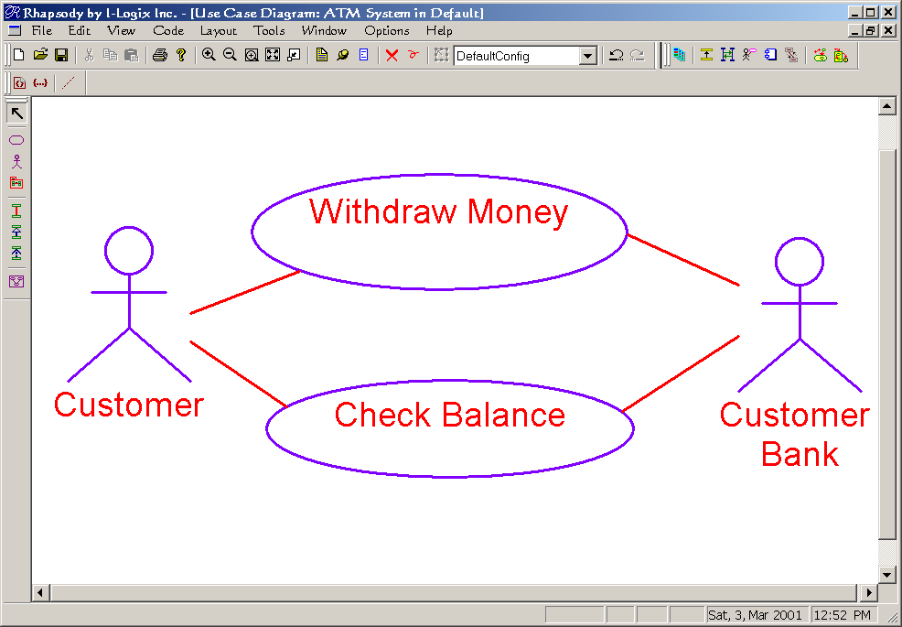
A Use Case ...
is a capability of a system
  why the user interacts with the system
returns a result visible to one or more actors
does not reveal or imply internal structure of the system
is independent of other use cases and may be concurrent with them
use case
actor

Slide 5
A Use Case
Is a high-level organizational unit for requirements
  Use case is a system capability
  Contains a coherent set of tightly related requirements around that capability
  Maps to 3-10 pages of textual requirements on average
Must be detailed to define specific requirements, via
  Scenarios and/or
  Specifications

Slide 6
A Use Case is used to
Capture requirements of a system
  Functional requirements
    What the system does
  Quality of service (QoS)
    How well the system does it
      speed
      throughput
      predictability
      capacity
      safety
      Reliability

Slide 7
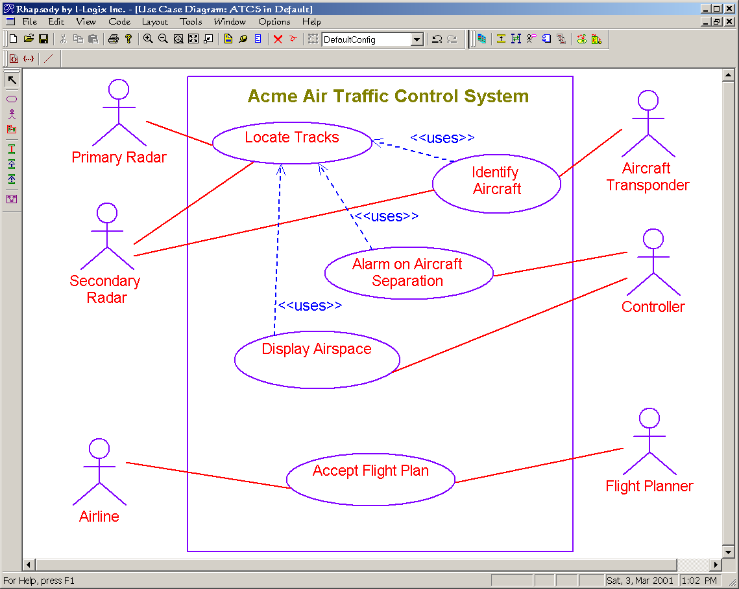
Use Case Syntax
system boundary
dependency
association
actor
use case

Slide 8
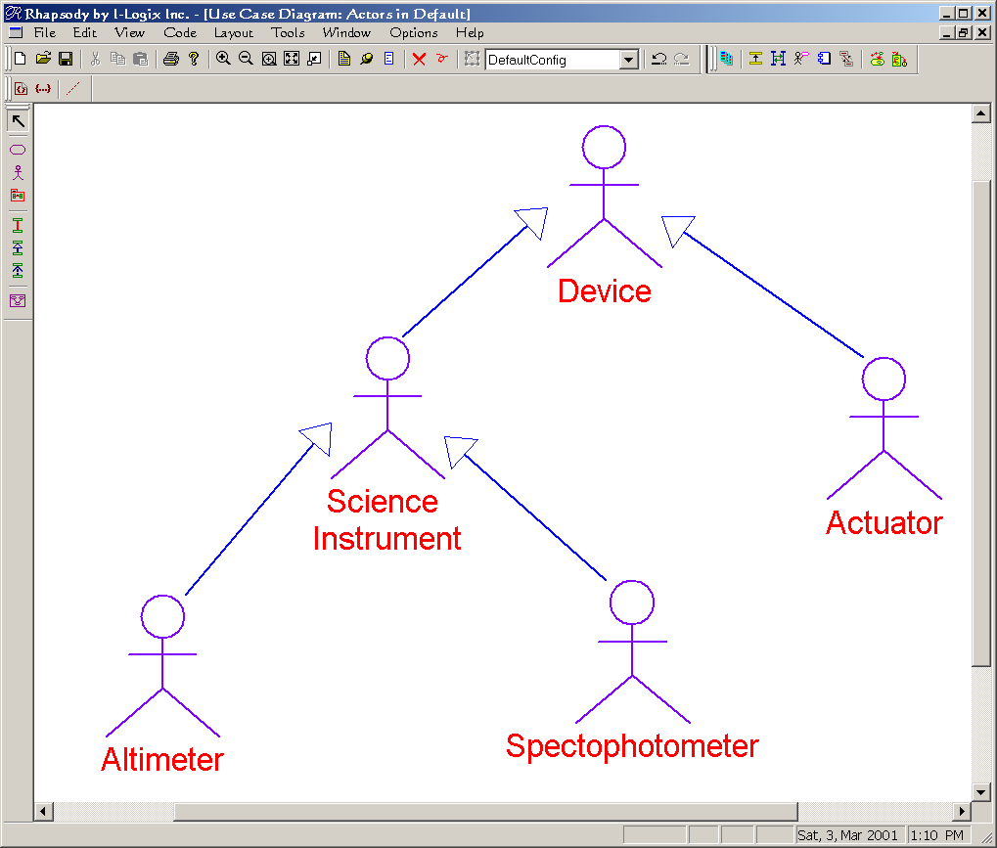
An Actor ...
is an object outside the scope of the system of concern that interacts the the system
  May be a human use
  May be a legacy system
  May be hardware
May be generalized
Don’t show
associations
between actors
!

Slide 9
Use Cases May be Applied ...
To the overall system
  All actors are external to the system
To pieces of the overall system
  Such as
    Subsystems
    Components
    Large scale objects
  Actors may be
    External to the system
    Peer-level pieces of the system

Slide 10
Use Case Description
Use Case Description Structure
  Name
  Purpose
    May be written informally (“The purpose of the capability is to…”
  Description
    May be written semi-formally (“The system shall…”)
    May be informal
  Preconditions
    What is true prior to the execution of the capability?
  Postconditions
    What does the system guarantee to be true after the execution of the use case?
  Constraints
    Additional QoS requirements or other rules for the use case

Slide 11
Use Case Structural Context
There is always a structural context to a use case
  System use cases: System use case diagram
  Subsystem use cases: High-level class or component diagram
The only objects permitted in a system use case are the “system” under consideration and the identified actors of that system
Never add objects
to a use case sequence
diagram without first
drawing the structural context
!

Slide 12
System Use Cases Example:
“Why should I buy the SleepyTime Anesthesia machine rather than the DeadToTheWorld machine?”
“Because SleepyTime:
  Has simple and understandable display and control human interface that minimizes learning time
  Can deliver various anesthetic drugs to the patients using vaporization
  Alarms on patient-critical events
  Ventilates the patient using the latest operational modes and techniques”

Slide 13
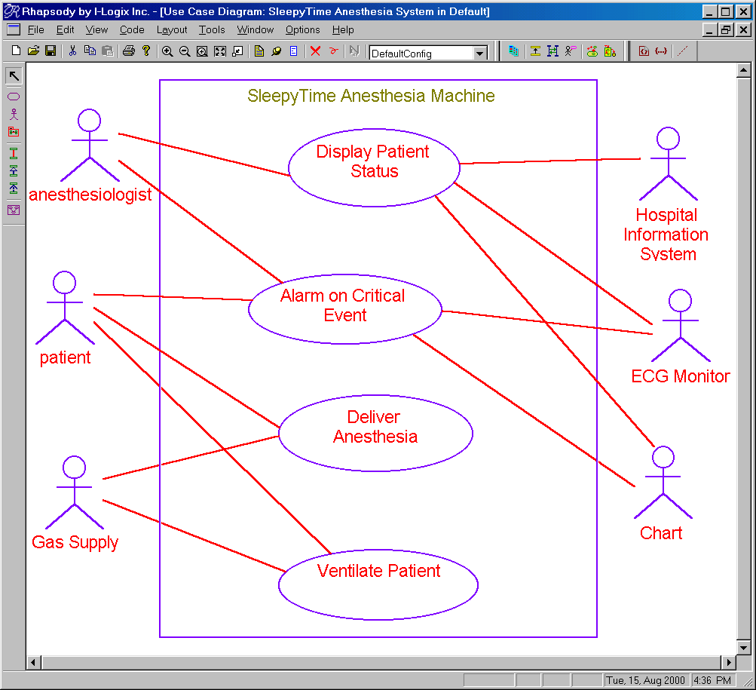
System Use Cases

Slide 14
Alarm on Critical Event
  Name: Alarm on Critical Event
  Purpose
    The purpose is to identify when the patient is at imminent risk and identify these to the attending anesthesiologist so that appropriate action can be taken
  Description
    The system shall identify and annunciate cardiac events of risk SERIOUS or greater within 10 seconds of their occurrence
    Alarms shall flash on the screen until cancelled even if the alarming condition ceases
    …
  Preconditions
    System is properly configured and has been initialized
  Postconditions
    Alarming conditions are displayed and audibly announced
  Constraints
    Alarms shall be filtered so that each patient condition results in a single annunciated alarm

Slide 15
Identifying Use Cases
Approach 1: From the Actor perspective
  Identify the actors
  For each actor, identify the set of different kinds of behaviors the system performs that are visible in terms of sending or receiving messages
Approach 2: From the System perspective
  Identify the set of interestingly different behaviors
  Identify the actors that work with the system in order to achieve it
System

Slide 16
Example: Cardionada
Cardiac pacemaker can pace the heart in different operational modes, Off, AAI, VVI, AAT, VVT, and AVI
  ([pace chamber][sense chamber][action on sense])
Pacemaker can be commanded by the external programmer to:
  Set pacing mode
  Set pacing parameters (rate, pulse width, pulse amplitude)
  Return pacemaker status

Slide 17
Example: Cardionada QoS
Pacing
  Pacing rate may be set in units of 1 ppm from 30..120 inclusive. Accuracy of pacing shall be <= 100 ms.
  Pulse width may be set in units of ms from 1..15. Accuracy of pulse width shall be within 0.25ms.
  Pulse amplitude may be set in units of mV from 10..100. Accuracy shall be within 2 mV.
Communications
  between the programmer and Cardionada shall be reliable with an MTBF of 0.01 in an electrically noisy environment.
  Single and dual bit errors shall be caught with an reliability of at least 0.0001%. Errors detected by the pacemaker shall be reported to the programmer. The programmer shall not assume successful transmission without explicit acknowledgement.

Slide 18
Example: Cardionada
Who are the actors?
  Programmer
  Heart
What are the visible behaviors?
  Set pacing mode
  Set parameters
  Get pacemaker status
  Pace the heart

Slide 19
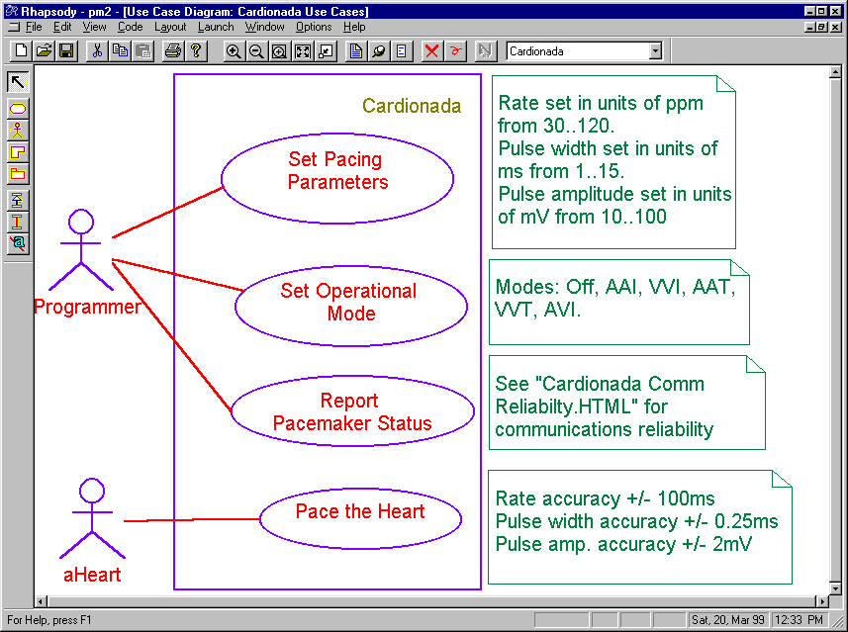
Example: Cardionada
constraint

Slide 20
Example: Cardionada
Note what is shown:
  Actors
  Use cases (functional capabilities)
  Constraints (QoS requirements)
Note what is not shown:
  internal workings of the actors
  internal workings of the system
the QoS requirements could
be deferred and shown as
applying to sequence
diagram messages
Note

Slide 21
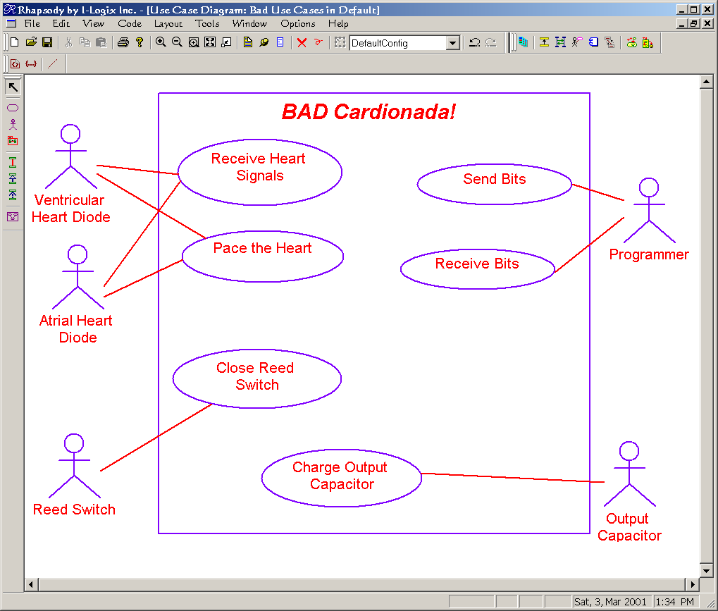
Bad Example: Cardionada
Not independent
wrong actor
Actor is inside system
Not primary capabilities
Assumes a design

Slide 22
Things to avoid
Single messages are not use cases!
  Use cases represent a large number of different scenarios
  Each scenario has many (possible hundreds) of messages
Low-level interfaces are not use cases
  Low-level interfaces are means to realize use cases
  LLIs are subsumed within actual use cases
  A use case should map to a reason for the user to interact with the system, not the means by which it occurs
!
!

Slide 23

Detailing Use Cases

Slide 24
Detailing Use Cases
By example
  Use scenarios captured via sequence diagrams
    Each scenario capture a specific path through the use case
  Partially constructive
  Infinite set, so you must select which are interestingly different
  Non-technical users can understand scenarios
By definition
  Use a statechart to represent all possible paths
  Fully constructive
  Non-technical readers may not understand it

Slide 25
Detailing Use Cases: Scenarios
A typical system has one dozen to a few dozen use case
Each use case typically has a few to several dozen scenarios of interest
Scenarios capture a specific actor-system interaction
  protocols of interaction
  permitted sequences of message flow
  collaboration of structural elements
  limitation of collaborations (constraints)
  qualities of service
  show typical or exceptional paths through the use case
Don’t show system
internal behavior
or structure
on a sequence diagram
!

Slide 26
Detailing Use Cases: Scenarios
An infinite set of scenarios is required to fully define behavior
Focus on scenarios
  that are “interestingly different”
  span all interesting variants of behavior
  Show each requirement relevant to the use case
You’re done when you’ve captured all the requirements relevant to that use case
Annotation Quality of Service (QoS) with constraints
{ msg a transmission is
permitted to fail 0.01%
of the time }
msg a
{ < 35us }
msg b

Slide 27
Detailing Use Cases: Scenarios
Many, but not all, use cases have a single “sunny day” or primary scenario
Many, but not all, use cases are originated by an actor
Scenarios are shown using sequence diagrams
  Add textual description incl.
    Purpose and/or description
    Preconditions
    Postconditions
  Vertical lines represent objects from the structural context
  Directed horizontal lines represent messages
  Time (or sequence) flows down the page

Slide 28
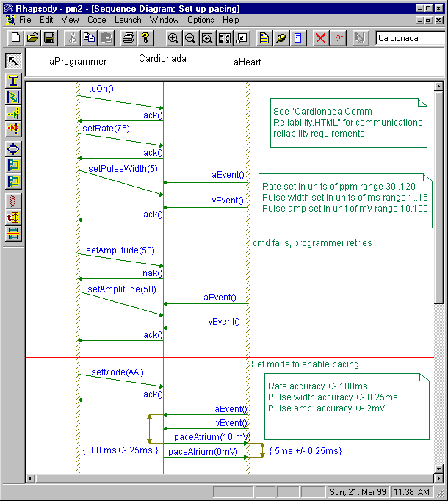
Detailing Use Cases: Scenarios
Instance line (instance of class, system, subsystem, or use case)
message
constraint

Slide 29
Problems with Scenarios for capturing requirements
There are an infinite set of possible scenarios
  Use case designer must select a subset that captures all relevant requirements
UML Scenarios do not have a causal model
  Cannot automatically be converted to test vectors
  Isn’t always clear what exactly is being specified
No way to define negative requirements
  i.e. The system shall not…

Slide 30
Suggested Solutions
Scenario coverage
  Add scenarios which are different in the sense that they add >=1 requirement
  Stop when you can’t find a new requirement to add
Causal Model
  Use case design must “color” messages and sequences to distinguish required things from non-required things via constraints
Negative Requirements
  Draw a disallow scenario and constrain the sequence as {DISALLOWED}

Slide 31
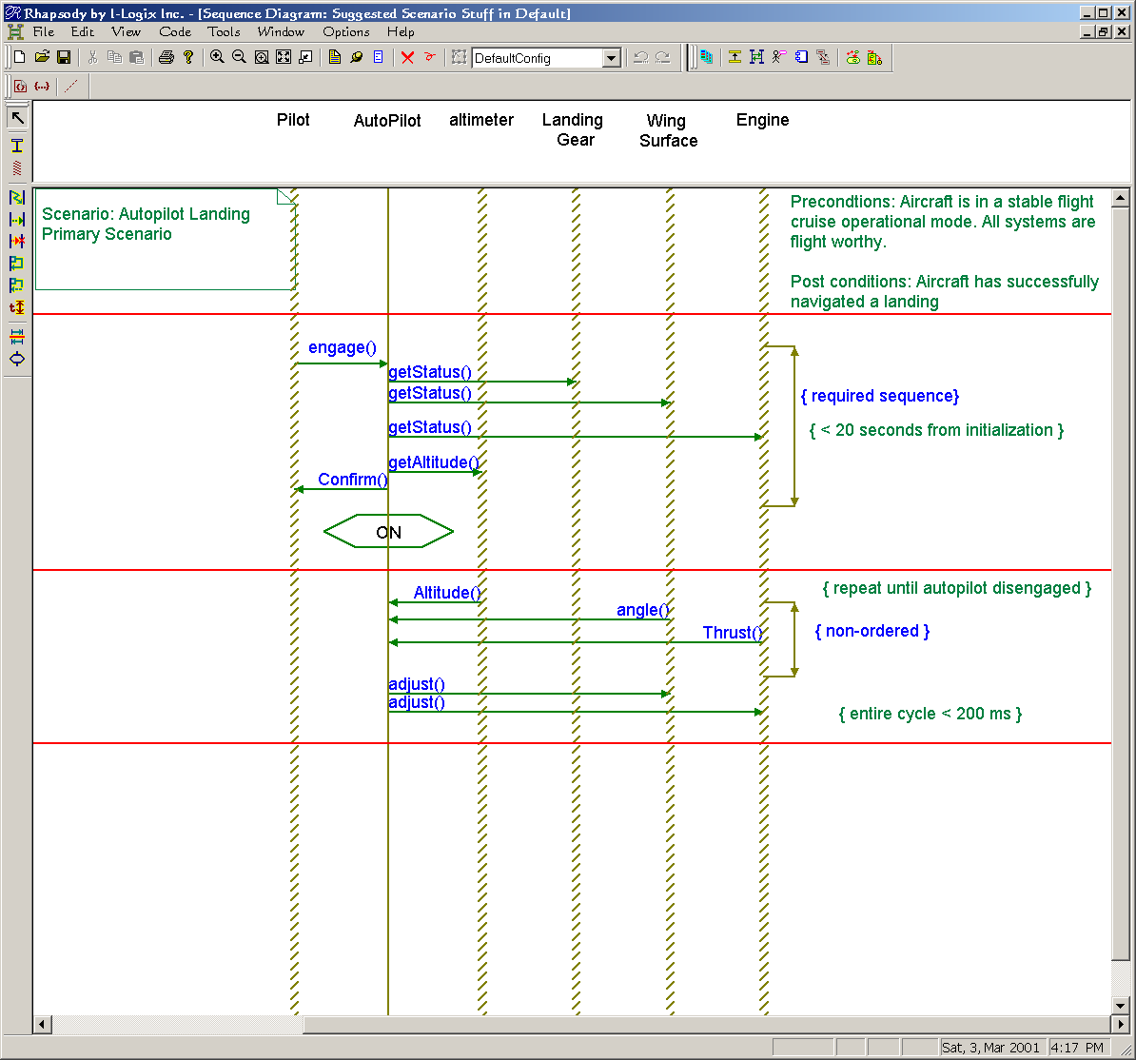
Suggestion Solutions
Pre and post conditions
Maybe either System or Use case under consideration
iteration
ordering
state
timing QoS

Slide 32
Caution on Sequence Diagrams
!
Only show the identified and agreed upon structural elements on a sequence diagram
  For a use case scenario, permitted objects are:
    the “system”
    identified actors
When more detail is desired a common architectural vision is required for the system to ultimately integrate!
  Then at that level, you can use the architectural pieces as objects within the use case scenarios

Slide 33
Detailing Use Cases with Statecharts
Note: This section assumes familiarity with statecharts

Slide 34
Detailing Use Cases: Statecharts
Statecharts are fully constructive descriptions that represent all possible scenarios on a single diagram
Useful for elaborate and complex protocols of actor-system interaction
  Represent actor → system messages as
    triggering events (edge triggered)
    conditions (guards) (level-triggered)
  Represent system → actor messages as actions

Slide 35
Detailing Use Cases: Statecharts
States represent conditions of existence of an object (e.g. the system or run-time instance of a use case) that persist for significant periods of time
States are distinguishable in one or more of the following
  messages (events) accepted
  actions or activities performed on event reception
  ongoing activities while in the state
  reachability graph of subsequent states

Slide 36
Finding States for Use Cases
A state is a use case condition in which
  a set of messages received from the actors is treated identically
  A common behavior is executed
  A common reachable set of subsequent states exist
Identify conditions in which the above are all true, e.g.
  Request to lower landing gear results in the landing gear lowered (action) and enter “approach mode” (state)
  Request to lower landing gear is ignored (“on ground” state or “cruising” state)
Hint
  Whenever you see “mode” in a textual spec, it implies a state

Slide 37
Statecharts and Scenarios
When a statechart is defined for a use case the scenario is a path through the statechart
Statechart defines all possible scenarios of the use case as different paths
Recommendation: From the statechart generate a sequence diagram that covers
  a unique non-looping path or
  each looping path exactly once
  at least one example of concurrent paths (if there are and-states)

Slide 38
Detailing Use Cases: Statecharts
Consider the following system:
  The operator can enter commands to control a telescope system, subject to a number of constraints
    When the telescope is idle, the system may be configured, maintained, or commanded to move
    The system will not accept a command when the telescope is currently moving except stop or turn off.
    Whenever the telescope is moving, monitored position is displayed in a blinking form
    When the telescope is stopped, the monitored position is non-blinking
    After configuration is complete, the user must reinitialize the system
    Telescope position is displayed on a user-defined periodic basis

Slide 39
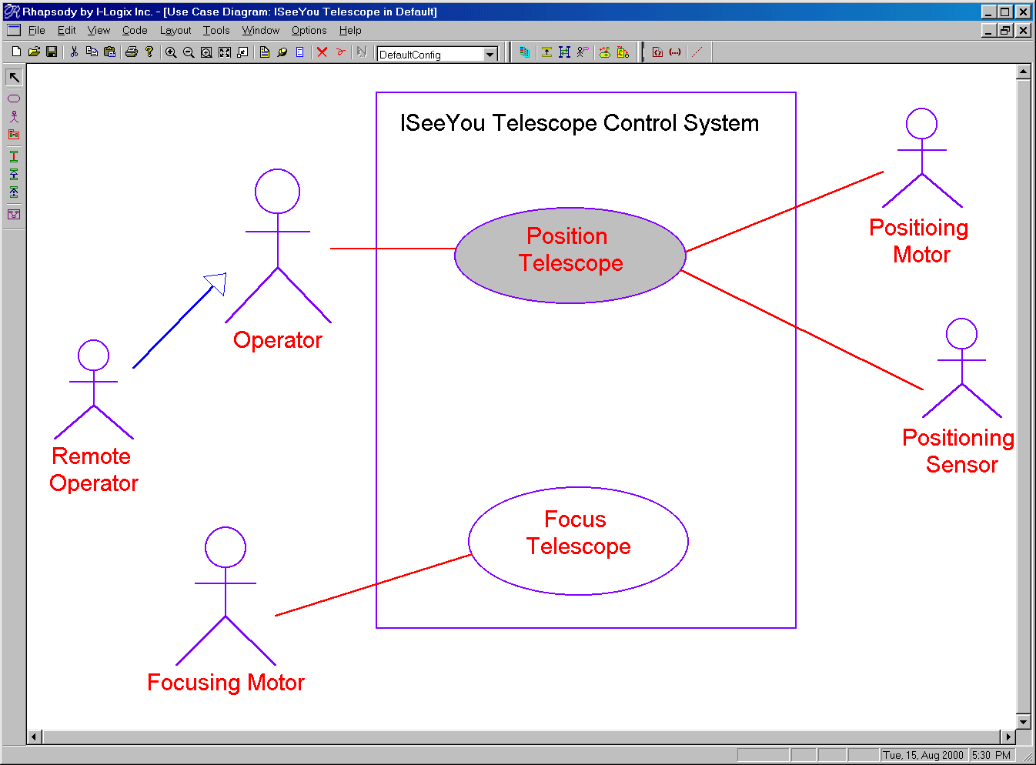
Detailing Use Cases: Statecharts

Slide 40
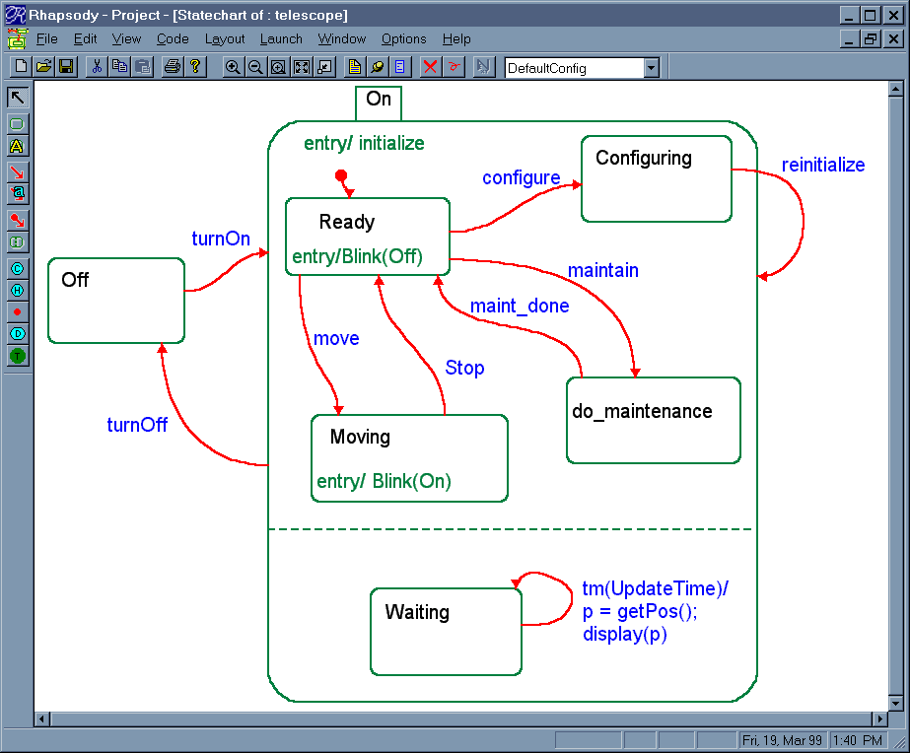

Detailing Use Cases: Statecharts
Position Telescope

Slide 41
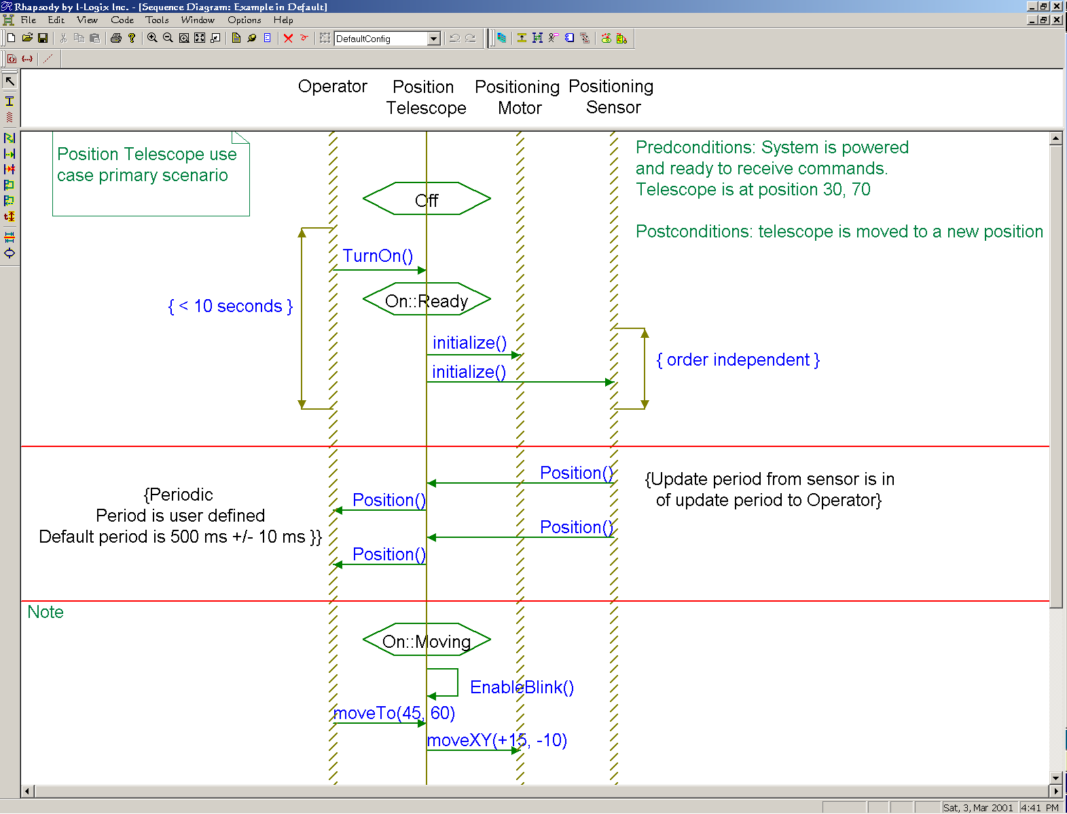
Example Derived Scenario

Slide 42

Connecting Use Cases and Design

Slide 43
Use cases → Object Analysis and Design
Use cases define requirements
  functional
  QoS
Use case are detailed
  sequence diagrams
  text and text annotations
  statecharts
Use cases are “black box” (i.e. do not reveal design or implementation)
Use cases are realized by collaborations
A collaboration is a
set of object roles
working together to
achieve a higher-level function
!

Slide 44
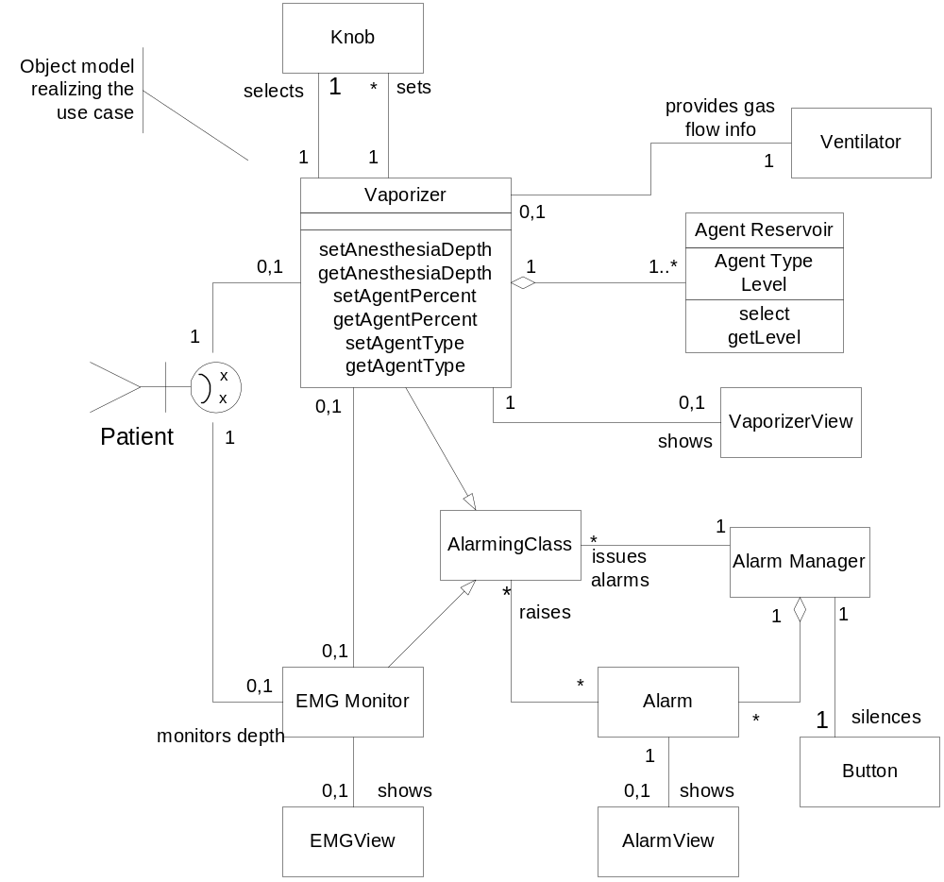
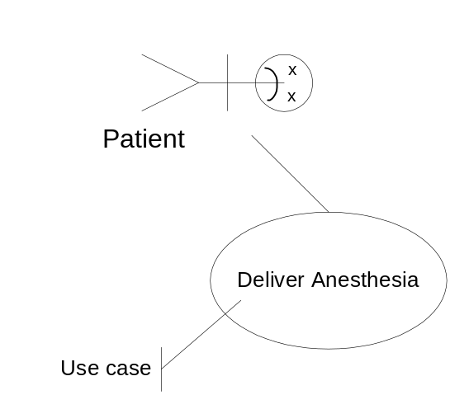
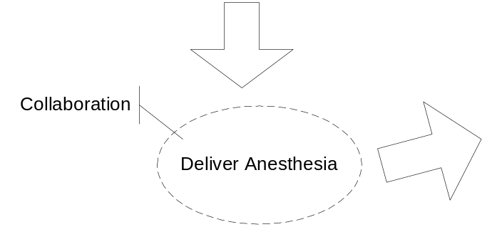
Collaboration Realize Use Cases

Slide 45
Connecting UC -> Design:
Simple Case
Use Case analysis
  Identify use cases
  Detail use cases with sequence diagrams
Design
  Apply object identification strategies
  Construct collaboration
  Elaborate use case scenarios with objects (i.e. add objects to UC scenarios)
  Test collaboration by executing all of the UC scenarios

Slide 46
Identifying Objects
Objects should be identified a use case at a time
Objects are identified by applying object identification strategies*
Scenarios are elaborated with the identified objects
Object collaborations are tested for correctness by executing the same set of scenarios defined at the previous level of abstraction but adding the newly found objects
*See Real-Time UML for a list of object
identification strategies

Slide 47
Connecting UC->Design:
Using Statecharts
Use Case analysis
  Identify use cases
  Detail use cases with statechart specifications
  Derive sequence diagram scenarios from statechart
Design
  Apply object identification strategies
  Construct collaboration
  Elaborate use case scenarios with objects (i.e. add objects to UC scenarios)
  Test collaboration by executing all of the use case scenarios but with the objects added

Slide 48
Connecting UC->Design: with System Engineering Model
Use Case analysis
  Identify use cases
  Detail use cases with sequence diagrams
Systems Engineering (subsystem-oriented)
  Identify subsystems
  Prove adequacy of subsystem architecture via execution of elaborated use case scenarios
  Decompose system use cases -> subsystem use cases
Mechanistic (collaboration-oriented) Design
  Identify objects using object identification strategies
  Test collaboration via execution of elaborated scenarios
  Map objects from collaboration into subsystems
  Test via execution of elaborated scenarios

Slide 49
System Use Cases

Slide 50
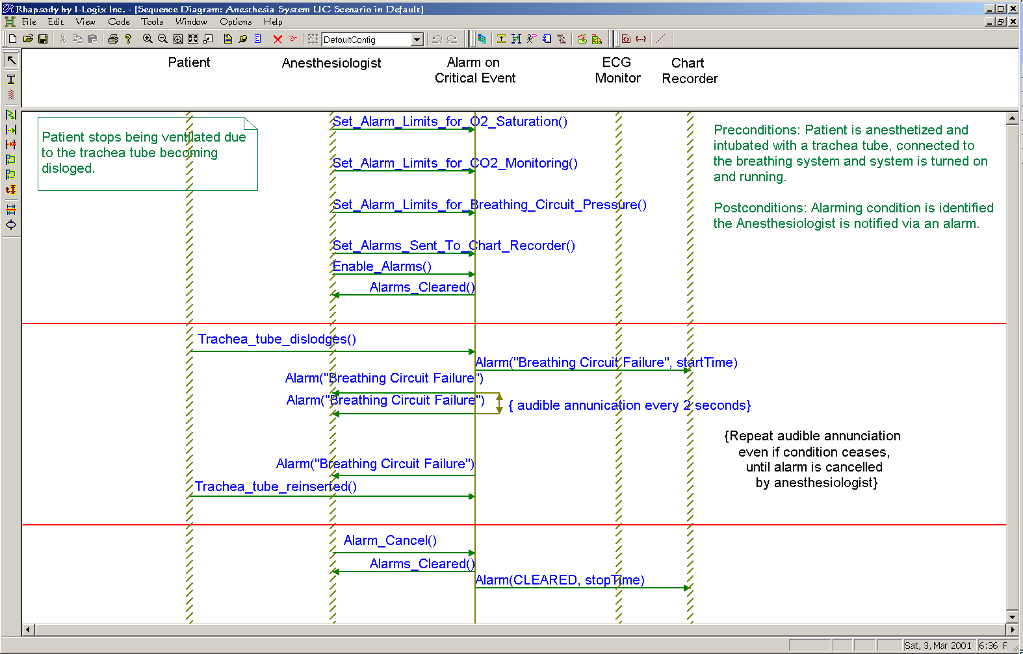
System Use case scenario

Slide 51
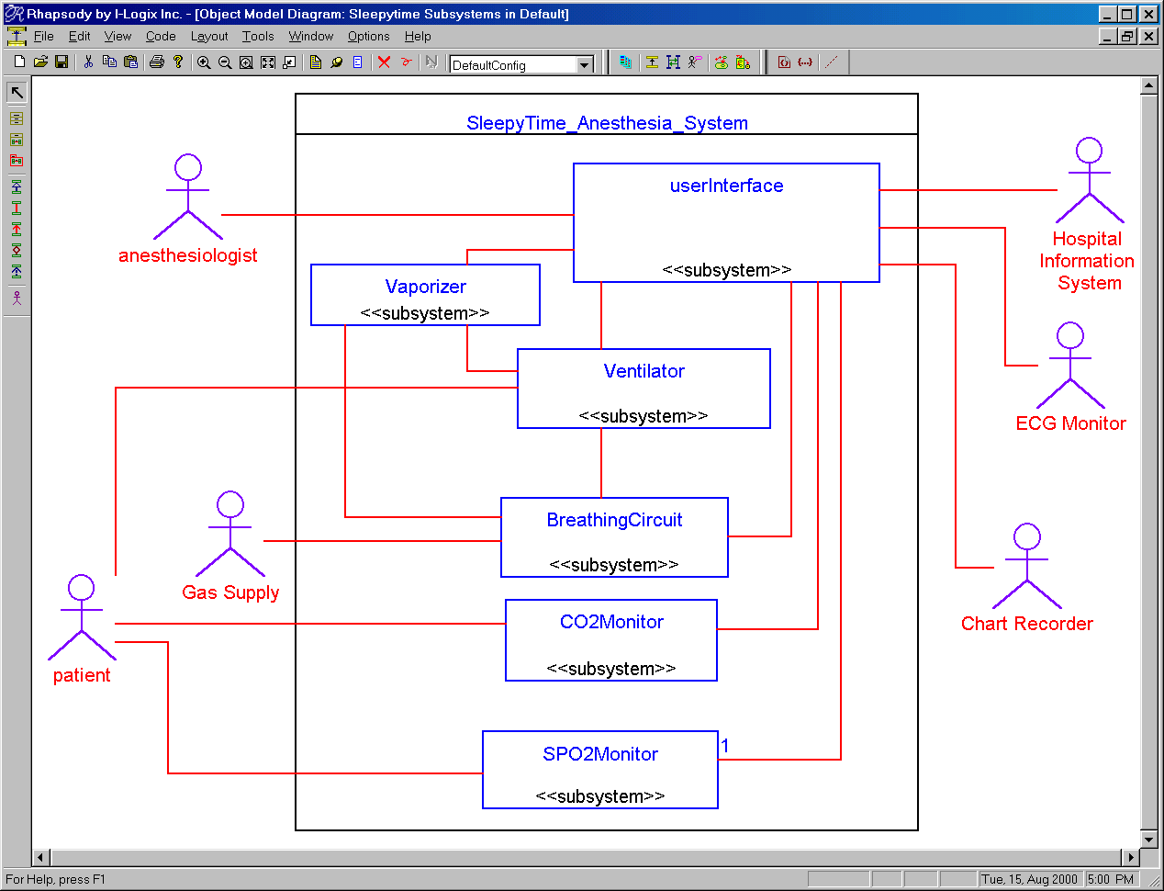
“Drilling Down”
Subsystem Use Cases

Slide 52
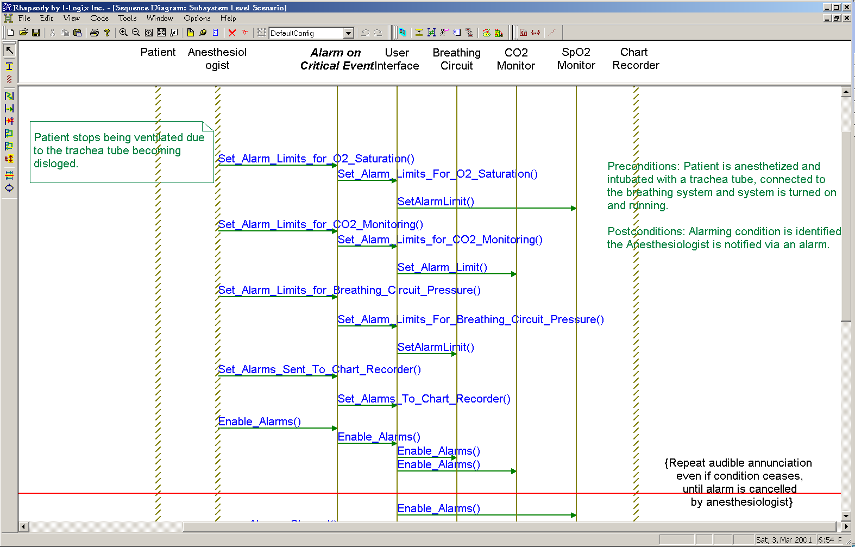
Subsystem-Level Elaboration
Use case
subsystems

Slide 53
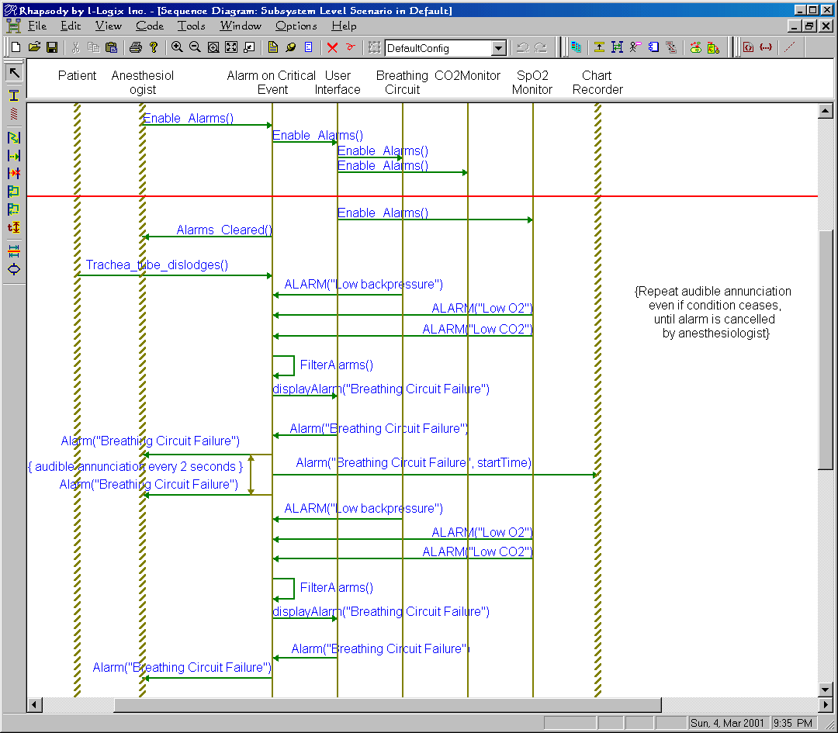
Subsystem-Level Elaboration 2
subsystems
Use case

Slide 54
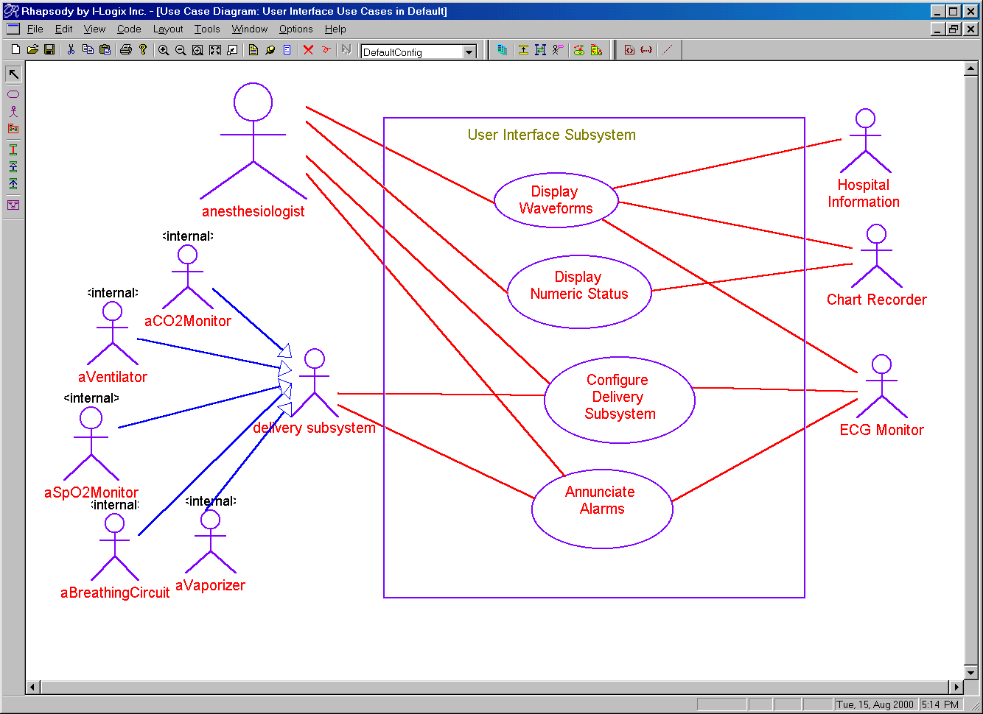
“Drilling Down” UI Use Cases

Slide 55
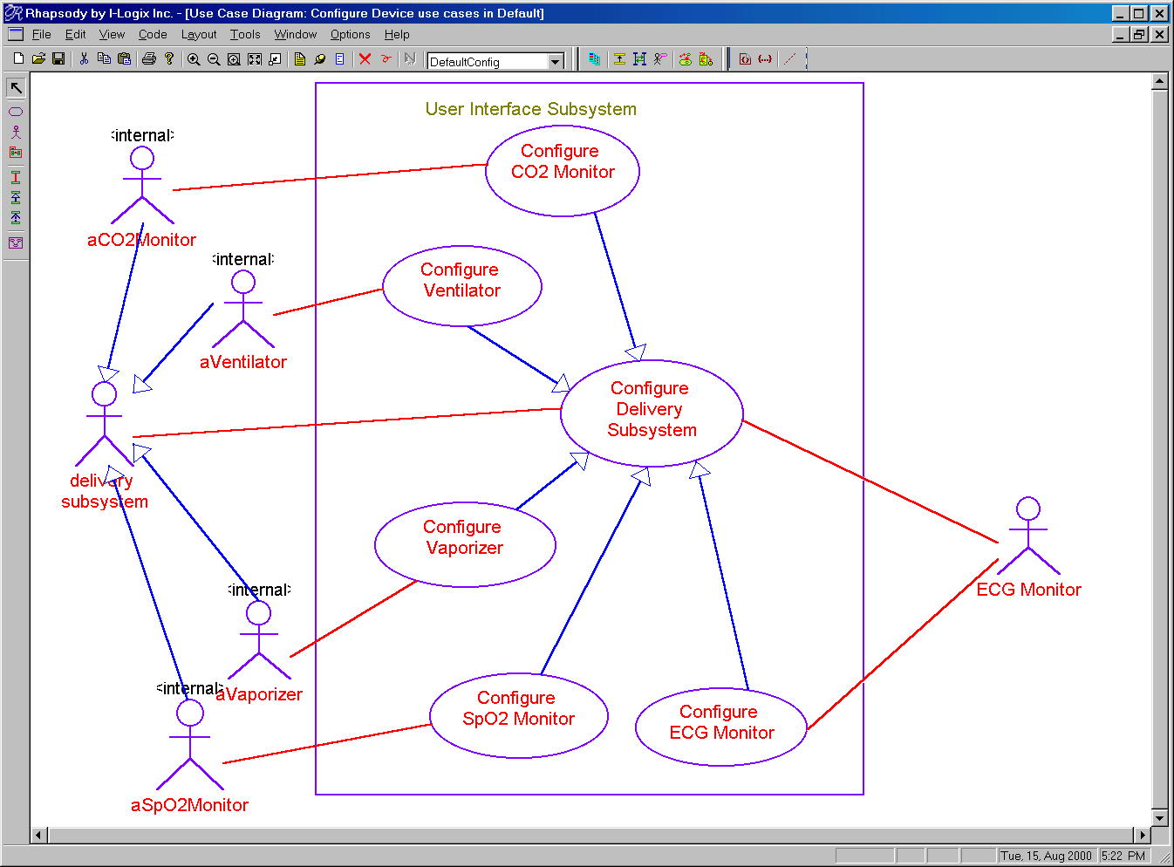
“Drilling Down” UI Use Cases

Slide 56

Applying Use Cases

Slide 57
Applying Use Cases
Waterfall lifecycle model
  All requirements are completed prior to any design or systems engineering
    Use cases are fully identified and detailed
Spiral lifecycle mode
  First iteration,
    all or most use cases are identified
    Only the use cases to be elaborated are detailed
  Subsequent iterations
    Use cases elaborated in that iteration are detailed

Slide 58
ROPES Iterative Process
Refined scenarios as test vectors
Implementation
Testing
System-level use cases test vectors
Unit
Integration
Coding
Testing
Testing
Validation
Detailed
Testing
Design
Iterative
Refined scenarios
Prototypes
Party!
Mechanistic
Design
Design
Requirements
Analysis
Architectural
Design
System-level use cases
Object Analysis
Systems Analysis
Expanded
use cases
Refined scenarios
Subsystem use cases

Slide 59

Advanced Use Cases

Slide 60
Use Case Relations
Generalization
  One use case is a more specialized or refined version of another
«includes» (used to be called “uses”)
  One use case includes another
«extends»
  One use case provides an optional extension of another
Don’t go crazy
functionally
decomposing
the system
!

Slide 61
Use Case Generalization
Use when one use case is a more general (or special) form of another
Use when the use cases are at a different level of abstraction
Validate User
Check Password
Check
Fingerprint Scan
Adjust Attitude
Adjust Attitude
with Rockets
Adjust Attitude
with Reaction Wheels

Slide 62
Use Case «includes» Dependency
«includes» is used when a common capability is required by a use case
Only use «includes» when the included use case is used by >1 use cases
Take Picture
Execute
Scheduled
Downlink
«includes»
«includes»
The point is not to
functionally
decompose the system
!
Turn Spacecraft

Slide 63
Use Case «extends» Dependency
Use «extends» to add optional capabilities at named extension points
The extended use case is only inserted in some subset of the primary use case’s scenarios
Execute Scheduled Downlink
«extends»
{ext pt: compression}
Extension points:
compression
security
Lossy Compression
«extends»
{ext pt: security}
User Validation
«extends»
{ext pt: compression}
Noloss Compression

Slide 64
It is possible to build
entire system requirements
models without using
use case relationships.
Use then sparingly!
!

Slide 65
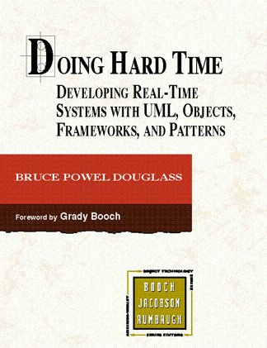
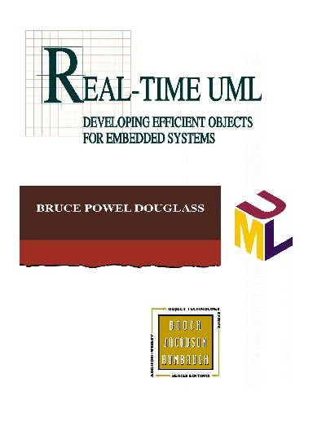
Some References of Interest

Slide 66

Additional Reading:
Use Case Guidelines

Slide 67
Guidelines for Use Cases
The purpose of a use case is to specify
  The system’s behavior that is visible to one or more actors
  The protocols of interactions (message flow) between the actors and the use case
  Usually, this is equivalent to 3-10 pages of textual requirements
Use cases achieve something of interest to an actor
Use cases should be run-to-completion, independent from other use cases, and may be concurrent with them
Variants of execution of a use case are the scenarios of that use case

Slide 68
Guidelines for Use Cases
Use cases may be applied recursively, to successively small “systems” within the context. However, there is always a structural context (and matching diagram) for the use case scenario.
Indicate actors outside the scope of the entire system using the UML stick figure icon. At lower levels of abstraction, use «actor» stereotyped class icons for actors that are within the system, but outside the scope of the subsystem under consideration.

Slide 69
Guidelines for Use Cases
Always write up a use case description (e.g., Word document page) that describes the use case:
  Definition of the actors and their roles in the use case
  Purpose of the use case
  The aspects of the use case visible to the various actor
  Pre- and post-conditions
  Special constraints and QoS requirements
Most use cases are initiated by an actor. This is not necessarily true for systems with autonomous behavior.

Slide 70
Guidelines for Use Cases
Number of scenarios
  If a use case has less than 3 scenarios, perhaps it is simply a collection of scenarios that belong to another use case.
  If a use case has more than 24 scenarios, perhaps it should be broken up into more use cases

Slide 71
Guidelines: Decomposition
For large scale systems with many use cases, break up the use case model into multiple diagrams. Decomposition strategies include:
  Group by generalization
    One generalization hierarchy per diagram
  Group by common actors
    If sets of use cases share actors to a large degree, group them together
  Managing many use cases
    Use UML packages to group use cases together
    Group by diagram

Slide 72
Guidelines: Use Case Relations
As a general rule, if you’re uncomfortable with the use case relations, don’t use them. They are not necessary to come up with a viable use case model.
Generalization means that one use case is a more general form of another. This is decomposition by abstraction.

Slide 73
Guidelines: «includes»
«includes» means that the parent use case is “bigger” than the included use case. This is decomposition by successive refinement.
Use «includes» when you want to
    Abstract away some sets of behavior common to multiple use cases
    Simplify the larger use case by treating it as a composition of smaller chunks

Slide 74
Guidelines: «extends»
«extends» is an optional extension to a use case – that is, some behavior that is optionally inserted as some named extension point in the primary use case.
  Use «extends» when you want to just model an optional piece of behavior in the extending use case

Slide 75
Guidelines: Actors
Actors may be humans, if you’re building the interface devices.
Actors may be devices, if they are provided to you.
Actors may be generalized
Don’t show non-generalization relations among actors – they are outside the scope. If necessary, draw a structural diagram that shows the system context.

Slide 76
Guidelines: Scenarios
The purpose of a scenario is to detail a relevant message sequence of a specific use case, thereby specifying the required behavior of the system with respect to the use case
Don’t add scenarios just for completeness – each scenario added to a use case model should add requirements and understanding.
Many, but not all, use cases have a single primary scenario
Model use case scenarios using UML Sequence diagrams

Slide 77
Guidelines: Scenarios
At most, the elements represented on a use case scenario are the actors to which the use case associates and the system (or subsystem) owning the use case.
  If there are elements (e.g. actors) represented in the scenario that are not in the use case, this is bad. It means either
    The scenario is at a more detailed level of abstraction than the use case
    The scenario is making (structural decompositional) assumptions that are not warranted by system model

